Slide 1
Brief History of Computing
Leaving Cert Computer Science

Slide 2
Learning Intentions
Identify important computer developments that have taken place in the last 100 years
Consider emerging trends that could shape future computing technologies

Slide 3
Excellent website for this topic
https://www.livescience.com/20718-computer-history.html

Slide 4
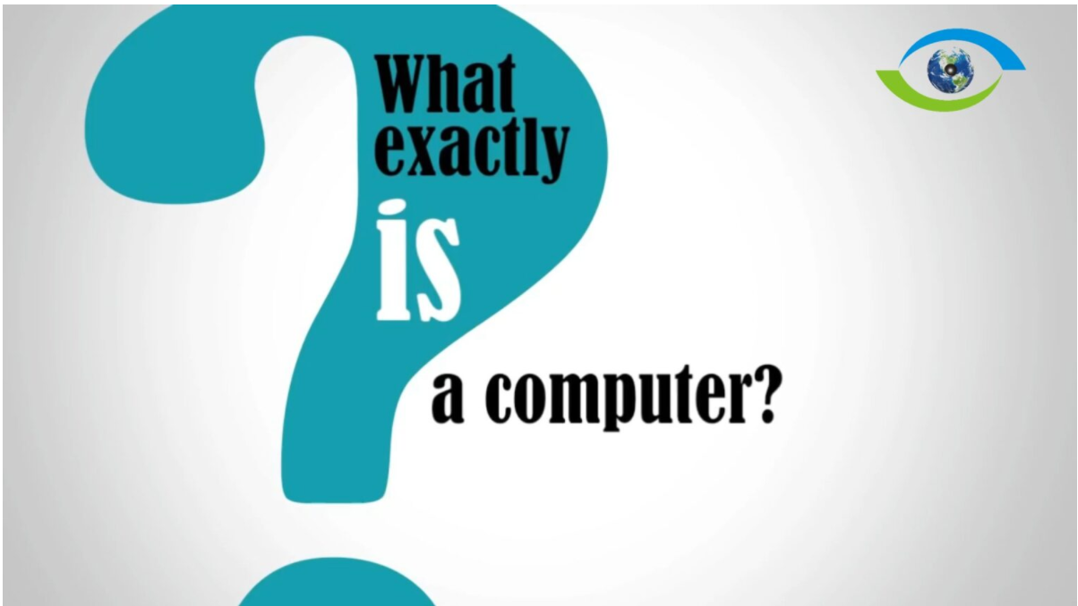
Learning Intentions – 1st November
Identify important computer developments that have taken place in the last 100 years
Consider emerging trends that could shape future computing technologies

Slide 5
What is a computer?
A computer is a general-purpose machine that can take in data(input), processes the data using a set of arithmetic or logical operations (program) and produces a result (output).

Slide 6
A General purpose machine
This means the device can carry out wide range of tasks, not just follow a limited set of instructions to achieve a specific purpose e.g desk calculator
A desk calculator not a computer as it can only carry out a small set of mathematical calculations.

Slide 7
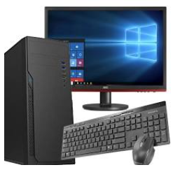
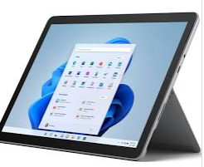
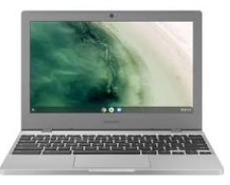
Todays Computers
They are programmable, and general purpose but such machines are a very specific type of computer. They are also digital, electronic computers

Slide 8
Digital and Analogue signals (video)
https://www.khanacademy.org/science/ms-physics/x1baed5db7c1bb50b:waves/x1baed5db7c1bb50b:digital-signals/v/digital-and-analog-information

Slide 9
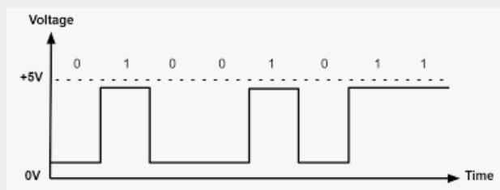
Digital computer
A signal is a representation of changing information. They are used to transmit information from place to place.
A digital computer operates using digital signals. These are discrete representations of information i.e. they can only have a limited number of values, in the below case 0 or 1

Slide 10
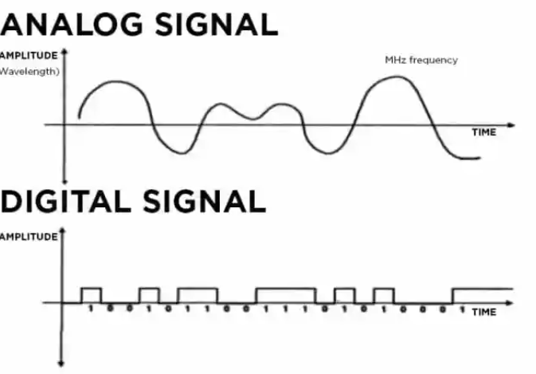
Digital computer
Information can also be transmitted using an analogue signal. In analog signals, the value changes continuously with time. The signal can have an infinite number of values

Slide 11
THe first Computers
The first computers were people.
As early as 17th century, the term computer was used to describe a person who performed mathematical calculations for different reasons:
  Compiling maths tables such as logarithms or trigonmetric values
  Calculating movements of celestial bodies such as planets, stars, moons etc
  Working out the trajectories of missiles for armies

Slide 12
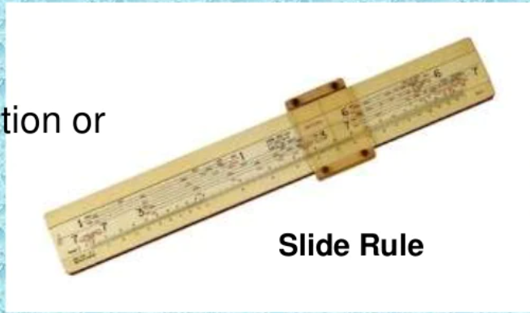
Early computing machines
THE SLIDE RULE
Early 1600’s, a mechanical analog computing device called a slide rule was invented
They were continually improved until they could calculate
  Logarithms
  Trigonometric functions
  Squares, cubes and their roots
Widely used up to1970s when they were replaced by the electronic calculator

Slide 13
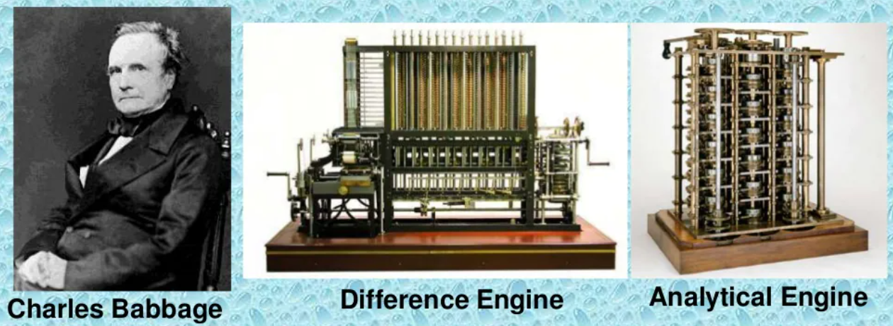
Charles Babbage – The Father of the computer

Slide 14

Charles Babbage – The Father of the computer
The Difference Machine (1822) was a mechanical calculator that could solve polynomial functions such as $x^{3}+7x^{2}$ + 5$x^{}$+ 3 = 0 It consisted of pulleys, gears, levers and many moving parts and was the size of a car
Babbage wanted to solve the problem of human computers introducing errors into mathematical tables
This was a mechanical marvel but still was a specific purpose machine and therefore falls short of our definition of computer

Slide 15
Charles Babbage – The Analytical Engine
The Analytical Enginewas invented by Babbage around 1830
Designed to carry out general purpose computation on data stored on punched cards
The computation was specified by programs stored on punched cards. The designs for the Analytical Engine included mechanical memory and a Central Processing Unit (CPU) to carry out the programmed instructions
The Analytical Engine never competed due to lack of funds
In todays terminology, the machine was programmable and general purpose and arguably the FIRST (NON_HUMAN) COMPUTER
https://www.youtube.com/watch?v=dWDQdwlK1GM

Slide 16

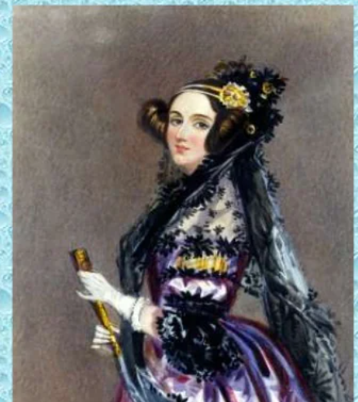
Ada lovelace – the first computer programmer
London-born Ada Lovelace (1815–1852) is credited with being the world's first computer programmer, as she drafted plans for how a machine called the Analytical Engine could perform computations.

Slide 17
The early 20th Century.
Many types of computers invented using mechanical, hydraulic and pneumatic means
All very complex, large and heavy making them very expensive and difficult to produce in large numbers

Slide 18
Alan Turing and the Turing Machine
Alan Turing was one of the first computer scientists
In 1936, Alan Turing described a Mathematical Model of computation called the automatic machine (a-machine). This later became known as the Turing machine
The Turing Test – The Turing Test is a method of inquiry in artificial intelligence (AI) for determining whether or not a computer is capable of thinking like a human being
https://www.youtube.com/watch?v=4VROUIAF2Do

Slide 19
Alan Turing and the Turing Machine
Alan Turing was one of the first computer scientists
In 1936, Alan Turing described a Mathematical Model of computation called the automatic machine (a-machine). This later became known as the Turing machine
The Turing machine is a simple theoretical “machine” that showed the true power of computing before modern computers actually existed.

Slide 20
the Turing Machine consists of 4 parts
A tape that symbols can be written to and read from
A head that does the reading and writing
A state register that stores the state of the machine any point in time
A table of instructions to tell the machine what to do next, depending on the current state and the symbol being read at the time e.g. write or erase symbol, move the head

Slide 21
Turing Machine – why are they important?
Turning machines provide a simple way to model general and powerful computational concepts and programs. This allowed modern computers to be theoretically studied before they physically existed
Video on turing machines
LC219ALP038EV.pdf ( examinations.ie)

Slide 22
Electromechanical Computers
1940’s – electromechanical computers developed. They had electrical switches to move mechanical parts.
1941 - The electromechanical Z3 was the first digital programmable computer to be built. The Z3 used binary numbers, high voltage represented a 1, low voltage represented a 0.
The use of binary reduced complexity compared to the decimal numbers used in Babbage’s Difference and Analytical Machines.
https://www.youtube.com/watch?v=3WNFBjoJbBA

Slide 23
Impact of the second World War
There was increased spending on computers and related devices by government and military during WW2
Code breaking was a critical challenge for the allies during WW2
A top secret operation was set up by the allies in Bletchley Park to address code breaking

Slide 24
Impact of the second World War
Alan Turing was a key figure at Bletchley Park. They used electromechanical devices called Bombes to crack codes created by the German Enigma machines (also electromechanical machines). This codebreaking helped shorten the war by several years
The Enigma machines and Bombes were designed for a specific purpose so are NOT general purpose computers. However they advanced many of the technologies needed to jump-start the era of the modern computer.

Slide 25
Impact of the second World War
Video on breaking the Enigma code

Slide 26

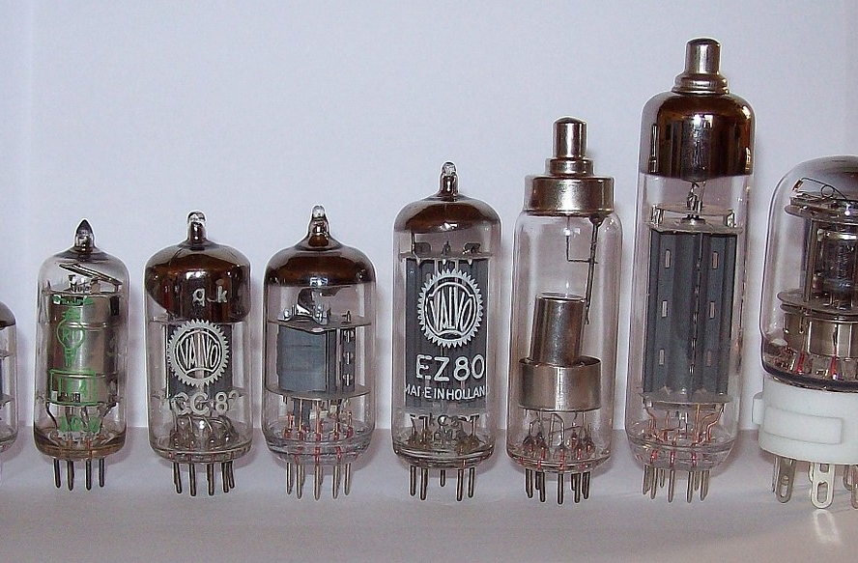
Vacuum Tubes –
The start of the electronic computer
1st generation of computers
Vacuum tubes are electronic devices that control the flow of electricity. They looked somewhat like a light bulb and similar in size.
Vacuum tubes are a glass tube device, which has had its gas removed, creating a vacuum space. It is comprised of electrodes that are designed to control electron flow between the electrodes sealed inside the vacuum tubes.

Slide 27
Vacuum Tubes and Electronic Computers
The development of the vacuum tubes led to rapid growth of electronic devices such as radio television and computers based on vacuum tube technology.
The relatively small size of these devices based on vacuum tubes and their relatively small cost of production, heralded the start of the modern electronic era

Slide 28
Vacuum Tubes and Electronic Computers
From 1940s onward electronic computer technology progressed at a rapid speed. Colossus in Bletchley Park was the first electronic, digital, programmable computer in later years of WW2. It was NOT a general purpose computer as it was designed for codebreaking
The first electronic, digital (1 and 0s) , programmable, general purpose computer was the ENIAC

Slide 29
Vacuum Tubes and Electronic Computers
The ENIAC was programmed by plugging and unplugging cables and controlling various switches. They could not store computer programs in their own memory. An Irishwoman Kay McNulty was one of the first programmers of ENIAC https://www.youtube.com/watch?v=k4oGI_dNaPc
These machines, all-electronic and based on vacuum tubes are known as the First Generation of Computers
Video on Vacuum Tube Computers

Slide 30
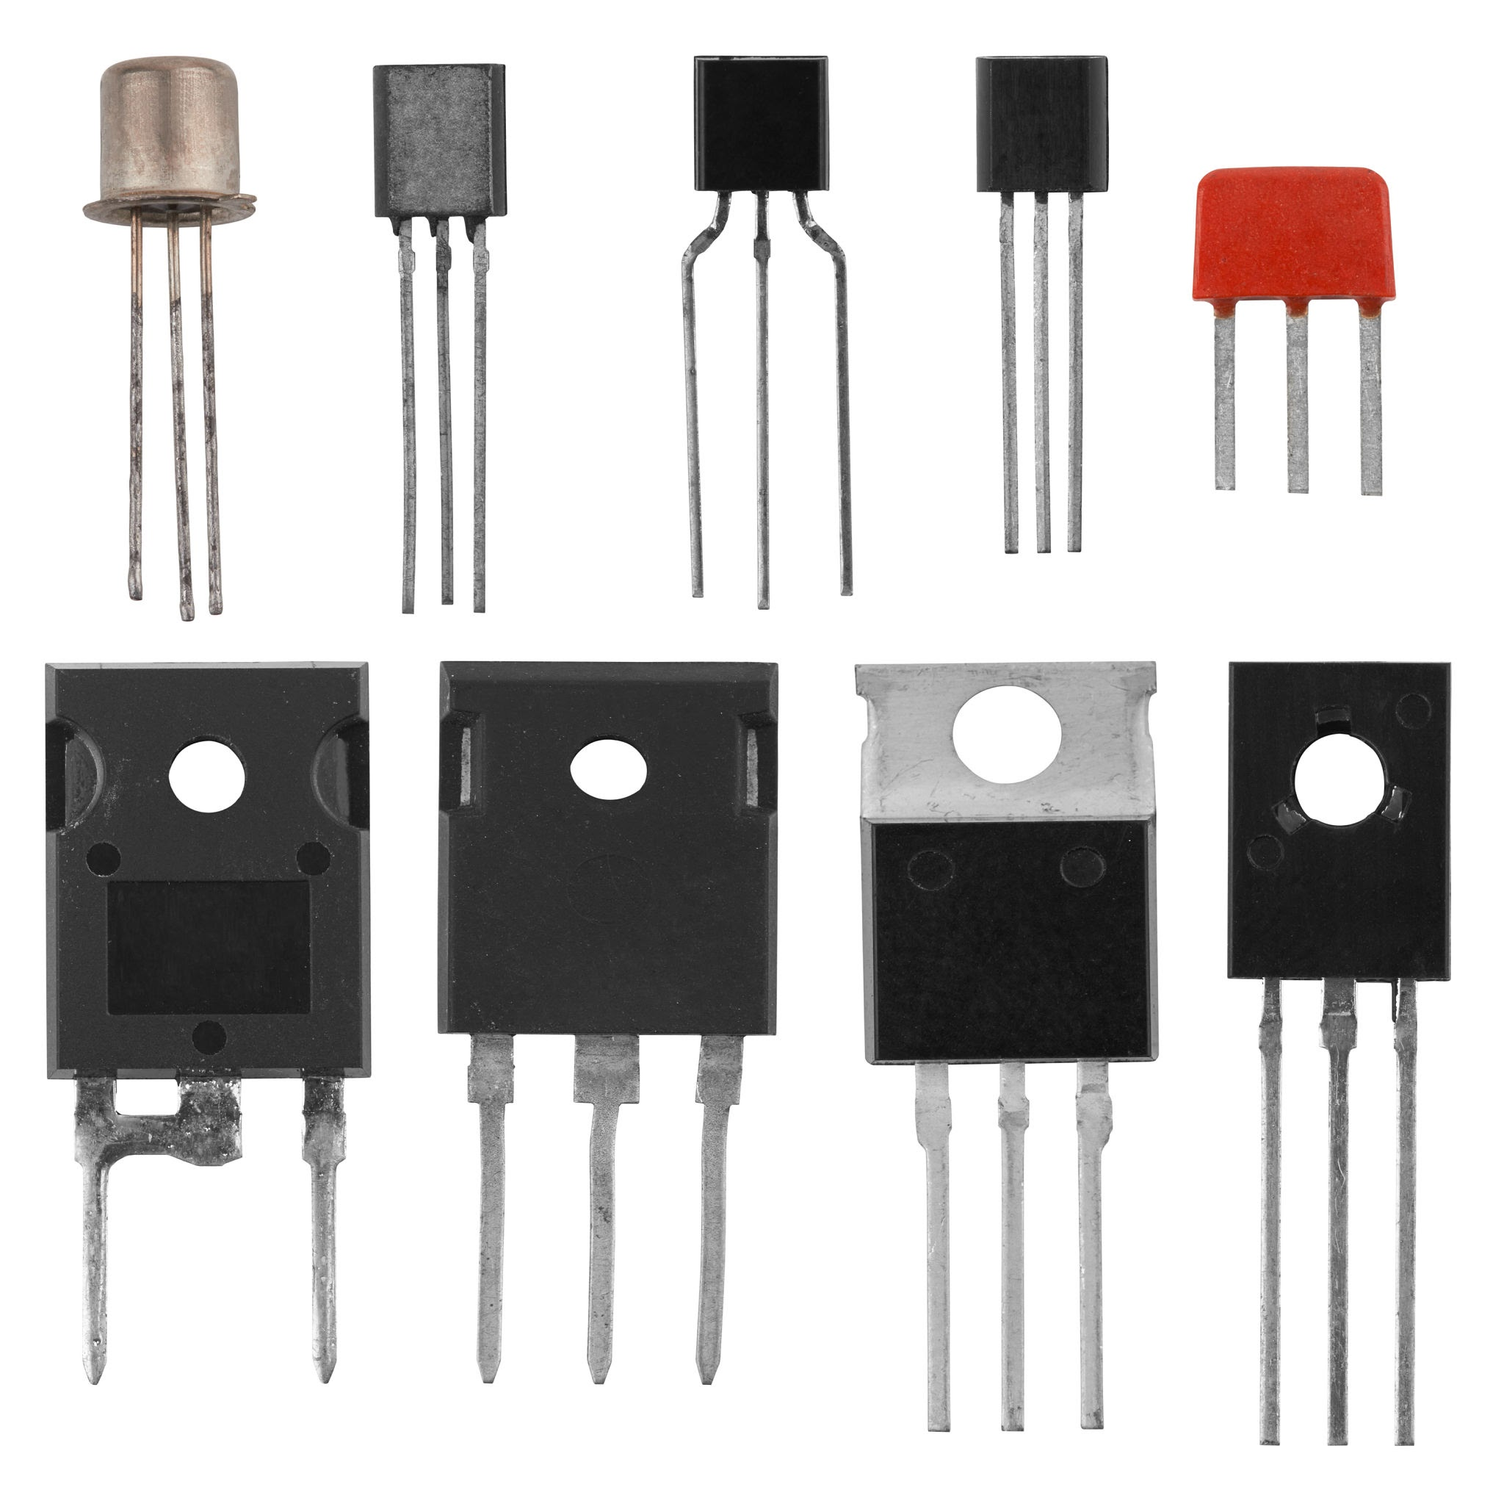
Transistors
The 2nd generation of computers
Transistors replaced the Vacuum tubes and this revolutionised electronics.
Transistors are very small electronic switches. They performed the same tasks as the Vacuum tubes but were smaller and more reliable, easier to mass produce, cost and energy efficient.

Slide 31
Transistors
Transistors were developed over many years mainly at the Bell Laboratory in New Jersey, USA. By late 1950’s transistor technology was so advanced that it rapidly changed the electronics industry, leading to 2nd Generation of Computers based on transistors instead of vacuum tubes

Slide 32
Transistors
The IBM 608 is considered the 1st fully transistorised computer that was available commercially. It performed 4,500 operations per second and cost over €500,000 in todays money
Transistors allowed for the development of “supercomputers” that could perform operation much faster than commonly available computers

Slide 33
Transistors
The Control Data Corporation (CDC) 6600 (1964) is considered the 1st commercially viable supercomputer. It could perform 3 million operations per second and cost approx. €20 million in todays money.
Video about 2nd generation computers

Slide 34
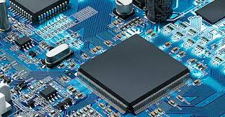
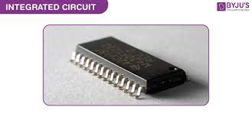
Integrated Circuits –
3rd generation of computers
3rd generation of computers came around 1960s and were based on integrated circuits
An integrated circuit is a collection of electronic components (resistors, transistors, capacitors, etc.) all stuffed into a tiny chip, and connected together to achieve a common goal.

Slide 35
Integrated Circuits
One of the most famous 3rd Generation computers is Apollo Guidance Computer (AGC) (1966) designed by Massachusetts Institute of Technology (MIT).
Margaret Hamilton designed the software for the AGC. Without this software, the Apollo program, which included landing the 1st people on the moon, would not have been possible
The AGC was designed to be small, around 32kg, and very robust because of the conditions it would work in.

Slide 36
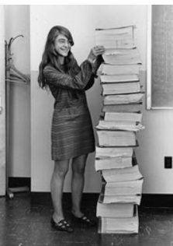
Margaret Hamilton Takes Humans to the Moon
Margaret Hamilton, born in 1936, is an American computer scientist and systems engineer from Indiana who led the Software Engineering Division of the MIT Instrumentation Laboratory. NASA credits her with coining the term “software engineering.” Hamilton worked on software development for Apollo 11, the first spacecraft to complete a successful mission that placed humans on the moon in 1969. Hamilton's insistence on thorough testing is credited with the mission's success and safety of its astronauts.

Slide 37
Integrated Circuits
In 1960’s and 1970’s, the 3rd generation of computers allowed the development of “minicomputers” which were small enough to move between different locations easily.
The integrated chip allowed computers to become much more powerful quickly. In 1970’s Cray Research, developed its own supercomputer, the Cray-. This started the modern era of supercomputing, which continues to drive many scientific discoveries.
Video on 3rd Generation Computers

Slide 38
Microprocessors
The 4th generation of computers is based on microprocessors. Most of todays computers are of this generation.
A microprocessor is a device used as the main brain of a computer system. A microprocessor is what we now call CPU, central processing unit.
CPU takes in binary data, performs operations on that data from instructions stored in its memory and the proves the result as output.

Slide 39
Microprocessors
Intel 4004 (1971) was the first microprocessor developed
Todays microprocessors contain billions of transistors on a single chip, less than the size of your palm. This allows personal computers to become practical and affordable in the late 1970’s / early 1980’s. This had led to computers everywhere in our lives today

Slide 40
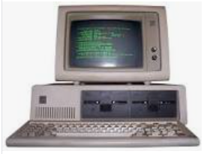
Personal computers
1975 - The 1st personal computers included models from Commodore, Apple, IBM.
These PCs had to be usable by non-experts. This led to the creation of operating systems and user-friendly interfaces such as Microsoft Windows (founded 1975) and hardware devices such as mice, keyboards and displays that we are familiar with today.

Slide 41
Modern computers
Modern computers include laptops, PCs, tablets, mobile phones as they are all digital, electronic, programmable and are multi purpose.
PCs costing a few hundred euros now have memory capacities and chips that operate at speeds that would have cost millions in the 1980s.

Slide 42

Modern computers
As the price of computers continues to decrease, their performance significantly increases.
The fastest supercomputer, Frontier (USA), can perform more than 1 quintillion (${10}^{18}$) operations per second. Essentially, Frontier can perform as many calculations in one second as 100,000 laptops.

Slide 43
The fastest computers - No 1
Frontier was built in 2022 by Hewlett Packard Enterprise in collaboration with its subsidiary Cray.
Frontier has a total of 8,730,112 cores. Each of its 74 computing cabinets weigh about 3650 kg and the entire system costs a whopping $600 million in total.
https://www.youtube.com/watch?v=etVzy1z_Ptg

Slide 44
Moore’s Law
The first Intel microprocessor (CPU), Intel 4004 (1972), had 2,300 transistors
Nowadays, a microprocessor (on a single chip) has billions of transistors. For instance an Xbox One has 5 billion.
In 1965 Gordon Moore states that the number of transistors on a microchip doubles every two years. The law claims that we can expect the speed and capability of our computers to increase every two years because of this, yet we will pay less for them. This is known as Moore’s Law.

Slide 45
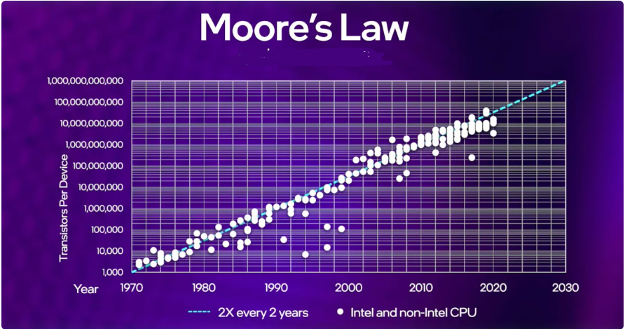

Slide 46
Moore’s Law
Experts agree that computers should reach the physical limits of Moore's Law at some point in the 2020s. One reason is:
  transistors will be unable to operate within smaller circuits at increasingly higher temperatures. This is due to the fact that cooling the transistors will require more energy than the energy that passes through the transistor itself.
https://www.youtube.com/watch?v=1qQE5Xwe7fs

Slide 47
The Next Generation of computers
This is difficult to predict due to rapid pace of development.
Possibly Quantum Computers based on quantum mechanical principles.
Quantum Computer prototypes exist but many barriers to overcome before they become viable. They are very sensitive to heat so must be kept at ultra cold temperature -273 celcius

Slide 48
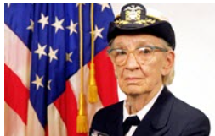
Grace Hopper Pioneers Computer Programming
American Grace Hopper (1906–1992) was an admiral in the United States Navy and a computer scientist who was one of the first programmers for the Harvard Mark I computer, which was a general purposes electromechanical computer used in the war effort for World War II.
1953: Grace Hopper develops the first computer language, which eventually becomes known as COBOL,

Slide 49
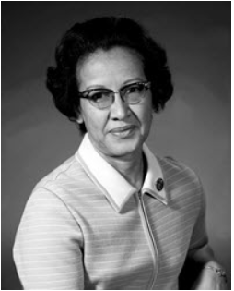
Katherine Johnson Executes Critical Space Calculations
Katherine Johnson, born in 1918, is one of the women immortalized in the 2016 book and movie Hidden Figures. A West Virginia native and American mathematician, Johnson helped confirm the accuracy of electronic computers used by NASA and performed critical calculations that ensured safe space travel from the 1950s on. She coauthored a research report that used equations for orbital spaceflight in 1960, performed trajectory analysis for the first human space flight in 1961, and ran equations on a desktop mechanical calculating machine before the 1962 orbital mission of John Glenn.
In 2015, she received the Presidential Medal of Freedom.

Slide 50
Female pioneers in computer science
https://www.youtube.com/watch?v=_ZjGOiJXVBA

